Slide 1
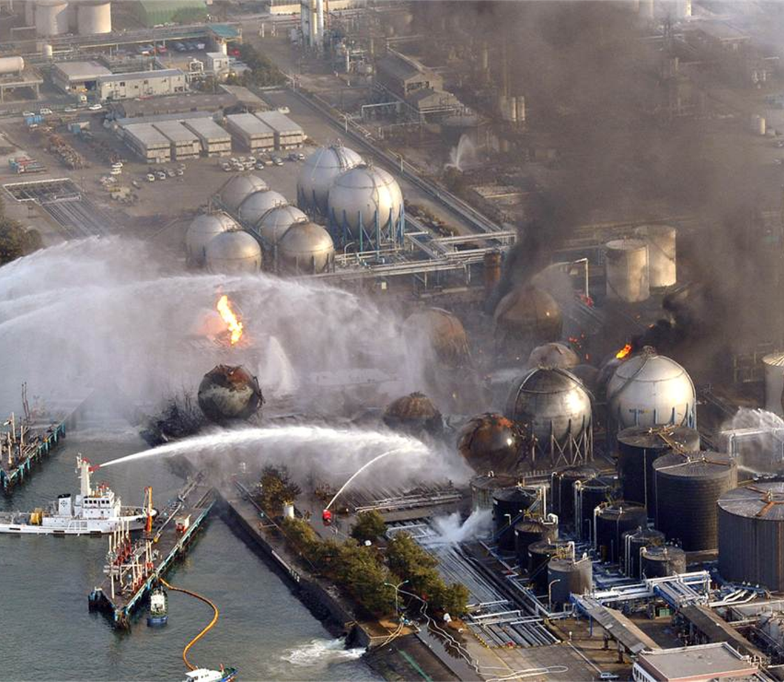
Accident Tolerant Fuel Cladding
Theo Propst | American Nuclear Society Student Section Vice President - Excelsior College
Fukushima Daichi, Associated Press 2011
Notes:
Briefly mention Fukushima accident in 2011, and the NRC’s response. Because of poorly engineered safety systems at Fukushima, the behavior of Zry-4 in beyond design basis scenarios was accentuated. Hydrogen was produced en masse, and explosions occurred at 3 of Fukushima’s reactors. While ATF has been in development far before this accident, since then the development of it has been encouraged and proliferated by multiple producers of nuclear power.

Slide 2
Fukushima Reactor #1 Timeline of Events- March 11, 2011
14:46-Reactor SCRAM, Diesels start due to ground acceleration (Earthquake). Core cooling online.
15:03- Reactor subcriticality confirmed.
15:27- First tsunami wave arrives
15:35- Second tsunami wave arrives
15:37- All AC power supplies lost. 125V Batteries flooded, causing additional loss of I&C.
21:35- Water supplied to IC shell via diesel powered fire pump
Notes:
2:46- Due to automatic shutdowns integral reactor safety, measures are in place to compensate for earthquakes and ensure proper reactor shutdown. Upon shutdown multiple decay heat removal methods were in place at Fukushima, all predicated on the maintaining some form of electrical power. One of these methods utilized a steam driven pump which pumped coolant to a condenser cooled by seawater. However, the pumps in that system were powered by the diesels once external power was lost, which again were compromised following the second wave.

Slide 3
Fukushima Reactor #1 Timeline of Events- March 12, 2011
01:48- Diesel driven fire pump malfunctions, shuts down.
05:46- Truck fire pump injection of freshwater to #1 Reactor Vessel.
10:17- Venting of containment boundary commences
14:53- 21,000 gallons freshwater injected, freshwater depleted.
15:36- Hydrogen explosion, aftershock
19:04- Injection of seawater by fire trucks commences
20:45- Injection of boric acid with seawater commences
03:38 (3/13)- Injection of seawater via fire lines commences.
Notes:
10:17- Venting of the containment boundary was in the hopes of decreasing the concentration of hydrogen in the vicinity of the reactor, as well as removing decay heat in the process. This was successful temporarily, however the reactor was still producing decay heat in excess of 10 MW. The root cause was still not being addressed, and still allowed hydrogen formation in large quantities. At 15:36 a hydrogen explosion rocked the building, concurrent to the aftershocks being felt at the time.
This was the first reactor unit to undergo a hydrogen explosion. Despite the fact that cooling was admitted to reactors 2 and 3, both also underwent hydrogen explosions on March 14 and 15.

Slide 4
History of Zirconium Cladding
Beryllium, stainless steel, aluminum were initial contenders, along with zirconium
Zirconium was discovered to have smallest neutron absorption window once hafnium impurities removed
Improvements were made over time, ushering in Zry-2 and Zry-4
Notes:
-All of these different metals were being investigated at Oak Ridge National Laboratory in 1946 following the war’s end. Hyman G. Rickover was tasked with developing a nuclear submarine for the nation’s use, and begin his search there. However, it became apparent that some were not the best products in an engineering sense.
-The use of Zirconium was pitched to him initially as a naturally occurring element, but also as one with a very low neutron absorption window, and beyond that very cheap to produce. To put this in perspective, the first contract issued for the production of zirconium by Rickover was that of 600,00 pounds at a rate of $10/pound. Even taking into account inflation, that’s still quite the price considering its application.
-Zircalloy-2 noted an addition of tin to the zircalloy chemical makeup. This increased corrosion resistance, specifically addressing the variability of it in reactor applications.
-Zircalloy-4 markedly decreased the amount of hydrogen absorption in Zirconium over time, increasing the life of the fuel, at least due to hydride formation.

Slide 5
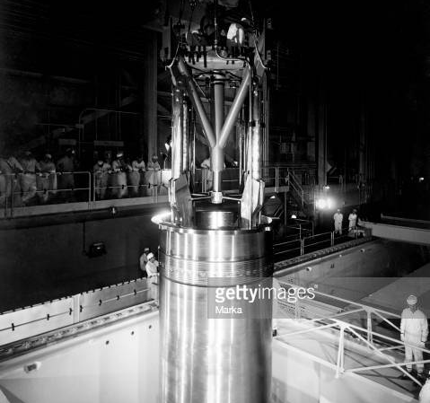
Zirconium Alloy-4 (Zircalloy-4 ) Cladding
High melting point (3360 F)
High thermal conductivity
Steady heat transfer properties throughout range of temperature operation
Low Neutron Absorption Cross-Section
Shippingport, PA
Notes:
The picture shown is the first civilian reactor plant (Shippingport, PA) used for electrical generation in the United States which utilized Bettis’ (Rickover’s) zircalloy cladding design. Up until the 1990’s this is the primary cladding material which had been utilized in the United States. Not only does it have a high melting point, but also high thermal conductivity. The heat being produced in the fuel itself must have a cladding which will transfer that heat into the coolant. Zircalloy cladding provides that, along with a very low neutron absorption cross-section. Not only does it readily transfer heat to the coolant, but also the neutrons that are carrying that heat energy.

Slide 6
Zirconium Alloy-4 (Zircalloy-4) Cladding (cont.)
Zirconium hydride is produced over time
  Zr + H₂→ZrH₂
ZrO₂ formation does not protect from additional corrosion
Low Neutron Absorption Cross-Section
Maintains geometry up until approximately 1480 F
Shippingport, PA
Notes:
-Formation of zirconium hydride can produce cracks in cladding surface. This reaction happens steadily happens over the life of the reactor fuel, but can be accelerated if hydrogen is produced in larger quantities. Hydrogen bubbling can occur additionally, which can then be “popped” when the fuel is placed under immense thermal stress.
-If the fuel gets hot enough, the resultant blistering produces pockets of fission product gases within the fuel material. These blisters can “pop” if the fuel reaches high enough temperatures with the combination of increased gas pressure, and release large amounts of these gaseous fission products.
-ZrO2 is the Zirconium corrosion product, which is formed over the life of the reactor as well. However, unlike other corrosion layers formed, ZrO2 does not provide protection to the lower layers of the metal. In fact, it can do the opposite. Larger pockets of ZRH2 can form and if conditions arise that cause removal of that corrosion a phenomenon called oxide spalling can occur. What this means is that when the corrosion layer is removed due to circumstances like chemical stress or large, sudden thermal transients, not only will the oxide layer be removed but also layer(s) of cladding material underneath. The Merriam-Webster dictionary lists “exfoliate” as synonymous with this word, so picture that in the context of our core material.
-These negative properties of Zry-4 cladding that showed themselves during the Fukushima accident are the primary reason the NRC had encouraged research into ATF.

Slide 7

ZIRLO Cladding (Westinghouse Electric)
Initially produced in 1990.
Consists of a proprietary percentage of zirconium, 1% niobium, and decreased Tin content as well
Will undergo lower growth percentage over given burnup in comparison to Zircalloy-4
Produces less fission product gases in comparison to Zircalloy-4 as well for the same burnup amount
Notes:
Even when compared to low-tin content Zircalloy-4, ZIRLO produces smaller corrosion growth amounts compared to both. When that corrosion does form, it will not produce localized concentrations of hydrides, again which is something that does occur in Zircalloy-4. This removal of the “blistering” phenomenon takes away the likelihood of hydride concentration, thus reducing the potential for hydrogen bubbling and release.
Decreased tin, along with niobium content greatly increases the corrosion resistance of the cladding. In Westinghouse’s report on ZIRLO’s properties, it was noted that it produced 76% of the oxides produced by standard Zry-4 (Sabol et. al, 1994). Increased corrosion resistance results not only greater general heat transferred, but also increased sustained performance at high power levels (which coincidentally are the conditions commercial plants are operated at). Lower fission product gas production also decreases the possibility of bubbling on the surface of the core, and the internal pressure being exerted on the exterior of the cladding.

Slide 8
ZIRLO Cladding (cont.)
ZIRLO cladding exhibits superior corrosion characteristics in comparison to Zry-4 in accident scenarios
Due to fundamental differences in the corrosion processes , ZIRLO will not damaged to the extent Zry-4 is even when corrosion does occur
Optimized ZIRLO is a higher-corrosion resistant, lower hydrogen-pickup candidate being utilized by dozens of units Worldwide.
Notes:
In LOCA scenarios, ZIRLO exhibits breakaway oxidation when in excess of 1800○F for 3600-4200 sec.
Meanwhile, Zry-4 exhibits breakaway oxidation almost immediately at temperatures greater than 1400○F.
-Due to oxide peeling occurring in ZIRLO instead of oxide spalling, which occurs in Zry-4, blisters do not occur and only the outermost layer of the cladding is effected. Even when the oxide layer is removed into the system the cladding still relatively has the same ability to transfer heat. This prevents a snowball effect occurring in the event of a loss of core cooling, thus increasing the cladding material’s performance in scenarios beyond the design basis of the fuel, giving operators and support personnel more time to re-initiate core cooling if it is lost for whatever reason.
Westinghouse’s Low-tin ZIRLO cladding was initially utilized in 2000, providing cladding material to a reactor in Spain. Optimized ZIRLO, a cladding model first utilized in the U.S. in 2008, is a cladding model showing increased corrosion resistance and less hydrogen pickup than even its predecessor.

Slide 9

M5 Cladding (Framatome)
Contains 1% Niobium like ZIRLO, but also contains controlled amounts of Oxygen and Sulfur.
Contains zero tin content in metal blend, greatly increasing corrosion resistance.
Outperforms Zry-4 counterpart much like ZIRLO.
Notes:
Because of eliminated tin content, M5 Cladding exhibits much less corrosion for the same burnup rate in comparison to ZIRLO, and much less than Zry-4. Additionally, M5’s fully recrystallized structure provides predictable trend patterns for creep and corrosion growth.

Slide 10
M5 Cladding (Framatome) (cont.)
Exhibits lower corrosion layer thickness than ZIRLO for same burnup rate
Has similar corrosion breakaway pattern to ZIRLO
Notes:
In 2000 material evaluation documented by the U.S. NRC, the M5 alloy material was evaluated at 1100, 1200, and 1300 degrees Celsius. Once the cladding temperature reached each respective temperature, it was immediately doused in cold water. No autocatalytic reaction was noted, confirming that in the event of a LOCA casualty, a 1000 degree Celsius peak central temperature would be considered conservative, and that no exothermic reaction like that which occurred in Fukushima would until at a much higher temperature.
Decreased corrosion properties, hydride formation, and increased resistance to steam oxidation are all improvements specifically focused at increasing fuel life and preventing adverse reactions in a sustained loss of cooling scenario. The 96 PWR’s currently utilizing this cladding design, along with their surrounding communities would all be benefitted by these properties in that scenario.

Slide 11
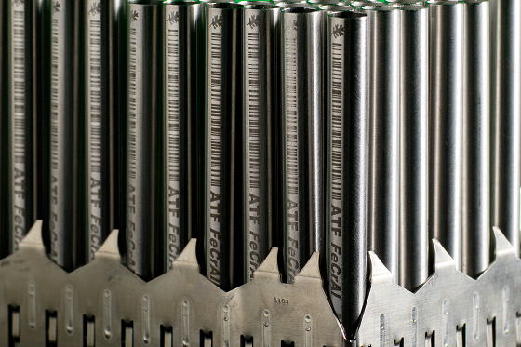
FeCrAl Cladding (Global Nuclear Fuel)
Lead Test phase, began development in 2012. Global Nuclear Fuel’s model is known as IronClad
Higher CHF than Zry based alloys.
Higher steam oxidation performance characteristics
Improved normal operating corrosion characteristics- no hydride formation!
Increased accident tolerance margins in core simulations
Notes:
Because of experimental phase, limited data is available regarding its performance over prolonged periods in commercial settings. However, lead test assemblies are currently being utilized by U.S. commercial reactors. Global Nuclear Fuel’s IronClad LTA’s are currently being used in Southern and Exelon plants.
Various tests have been done utilizing this cladding material at Oak Ridge National Laboratory utilizing a variety of simulations, including MELCOR. MELCOR is a simulation code developed by Sandia National Labs and utilized by the NRC to map plant/system/component response and progression during accidents. The model was utilized by ORNL using Peach Bottom Reactor #2 with multiple set assumptions regarding plant response. The core cladding response (which in the case bottom would be ZrO2) was substituted with the FeCrAl cladding data, to be taken into account for plant response.
In the event of total loss of DC immediately after shutdown, not only did the use of FeCrAl produce a margin of 2 days more in time before a hydrogen deflagration, but over 10 in the event that DC power was lost 4 hours after shutdown.
In simulations measuring the production of alumina oxides in steam environments, the cladding was producing an oxide layer even up to 1500 degrees Celsius, with a melting point of 1520. That means that even up to its melting point, breakaway corrosion will occur only right before, at least when temperature alone is a factor.

Slide 12
FeCrAl Cladding (Global Nuclear Fuel) (cont.)
Key limitations are the increase in cost in the fabrication process, as well as enrichment process of U-235.
Fuel enrichment accounts for 20% of a reactor plant’s costs
Current enrichment limits of U-235 are 5%.
Notes:
-Because of increased neutron absorption in FeCrAl, the cladding material will not only be more expensive to manufacture, but also must be thinner to allow the transfer of ample thermal neutrons to the moderator.
-Fuel enrichment costs can be addressed by increasing enrichment, or discharge burn-up, but both are constraints which most operators are currently operating at. A study regarding the advantages of raising such limits was conducted in 2018 by the Electric Power Research Institute, and significant potential economic gains were determined. However, achieving such gains would require regulatory changes and substantial investments.
-Overall, FeCrAl cladding exhibits much higher accident tolerance to the circumstances displayed at Fukushima. The increased tolerance to steam oxidation, blistering, and hydrogen formation put it head and shoulders above its Zry counterparts in that realm. However, until it can be a financially achievable product it may could be a significant time period before it is proliferated throughout the entire industry.

Slide 13
Questions?

