Slide 1
BWR Design, Dynamics, and Chernobyl Disaster
Nathan Cox

Slide 2
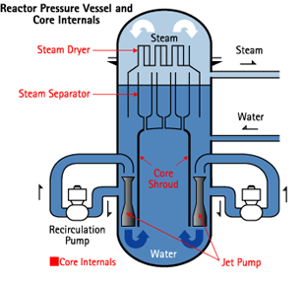
Basic Reactor Design – Generic GE
Notes:
Explain different components (recirc pumps, shroud, draw in core and rods, overall flow through core)

Slide 3
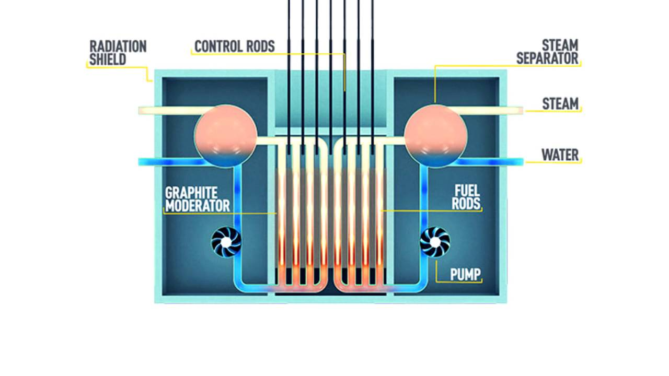
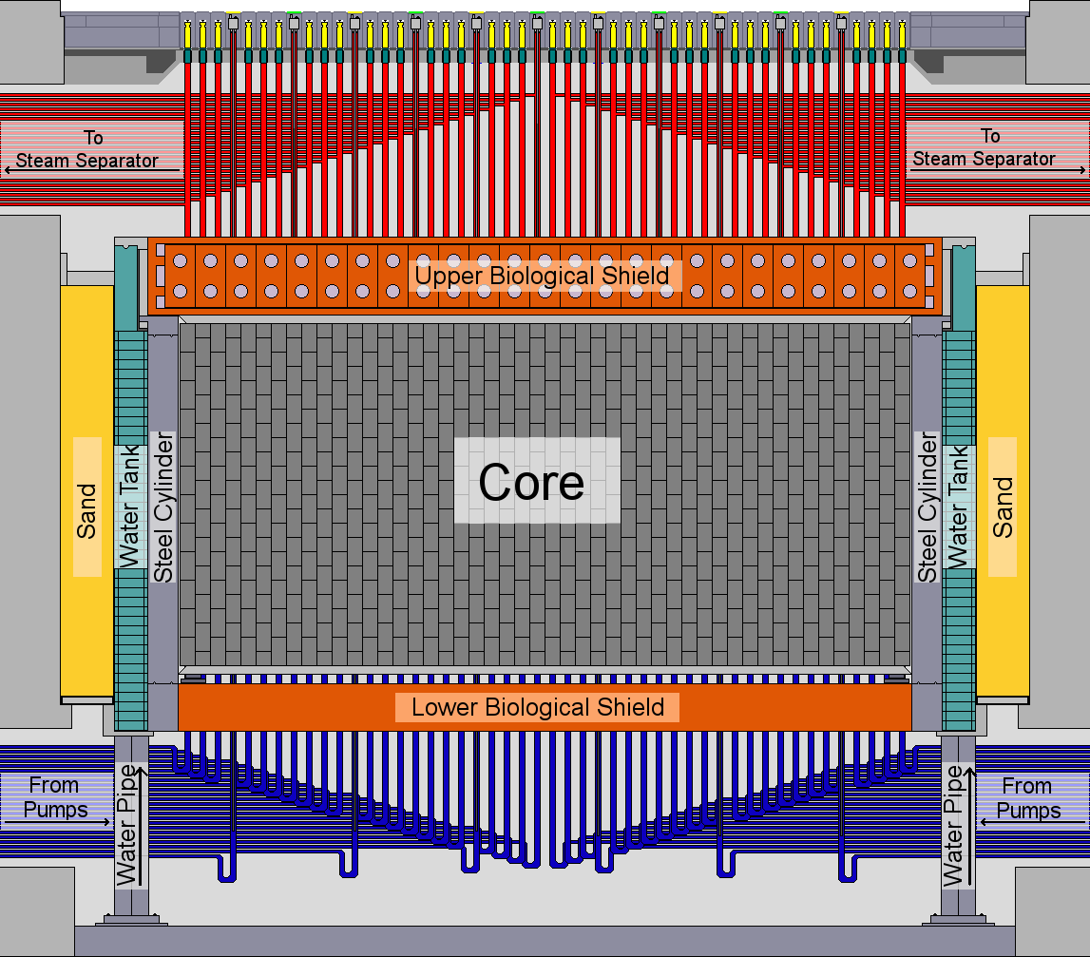
Basic Reactor Design-RBMK1000
Notes:
Pressure tubes, thousands of welds, containment design (see below), moderator, coolant channels, overall flow, rod followers
Accident Localization System. RBMKs are
protected by an Accident Localization System
(ALS). This pressure suppression system encloses
part of the main circulation circuit and consists of
leak-tight compartments. All main pipelines,
headers, and components carrying cooling water
are part of the ALS. The ALS differs considerably
in design from one plant to another. The reactor
coolant system of first-generation RBMKs is not
enclosed in a leak-tight ALS, as is the case at the
other RBMKs. Even in these other RBMKs, however,
only part of the reactor coolant circuit is

Slide 4
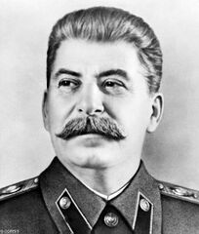
RBMK1000 Design Advantages over GE
Economics
  ONLINE REFUELING
  ALMOST NO ENRICHMENT
  Proliferation
  Cheaper to build

Slide 5

RBMK Design Disadvantages to GE
Positive Void Coefficient
Containment?
Welds, welds, welds
No passive DHR
Hard to control at low powers
Positive initial SCRAM reactivity
Rod followers
Notes:
Rod followers caused positive scrams
Positive void coefficient talk about in next part
Thousands of pressure tubes. Thousands of welds
Hard to control at low powers (oscillations)

Slide 6

Reactivity Balance
Power Reactivity Coefficient Breakdown
  Void Coefficient
  Fuel Temperature (Doppler) Coefficient
Moderator Temperature Coefficient
Sm
Xe
$$ρ_{Power}+ρ_{MTC}+ρ_{Xe}+ρ_{Sm}=ρ_{excess(fuel)}$$
Notes:
Xe plays a role later
Doppler broadening small effect overall
Ignore Sm

Slide 7
Light Water Reactor Power Comparisons
Bwr
pwr
Reactor power driven by voiding
No boron used during normal operation
Voiding is controlled by changing flow, pressure, or heat generation (pulling control rods)
Reactor power driven by water temperature and boron concentration
Notes:
Boron can make MTC positive depending on time in core life

Slide 8
Power Reactivity Comparison
LWR BWR
RBMK
Void Coefficient is Negative
  Water is moderator and coolant
Void Coefficient is LARGE positive
  Graphite moderated; water cooled
Notes:
Graphite moderated cores water acts as poison > less water (more boiling) > more moderation > more power

Slide 9
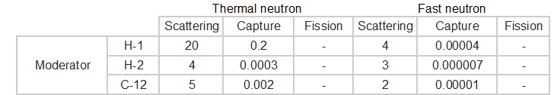
Scattering and Absorption Data for Water and Graphite

Slide 10
The Non-Nuclear Chain Reaction that read to Prompt Criticality
Poor attitude toward reactor safety during design
Positive Void Coefficient
Positive SCRAM
Poor attitude toward reactor safety during normal operation
Not following procedures (numerous examples)
Steam Explosion
Test ran by non-nuclear expert
NO ECCS available
Containment Design
Prompt criticality
Reactor Accident
Social Dynamics
Get it done
Lax attitude toward safety and training
Cover up problems

Slide 11
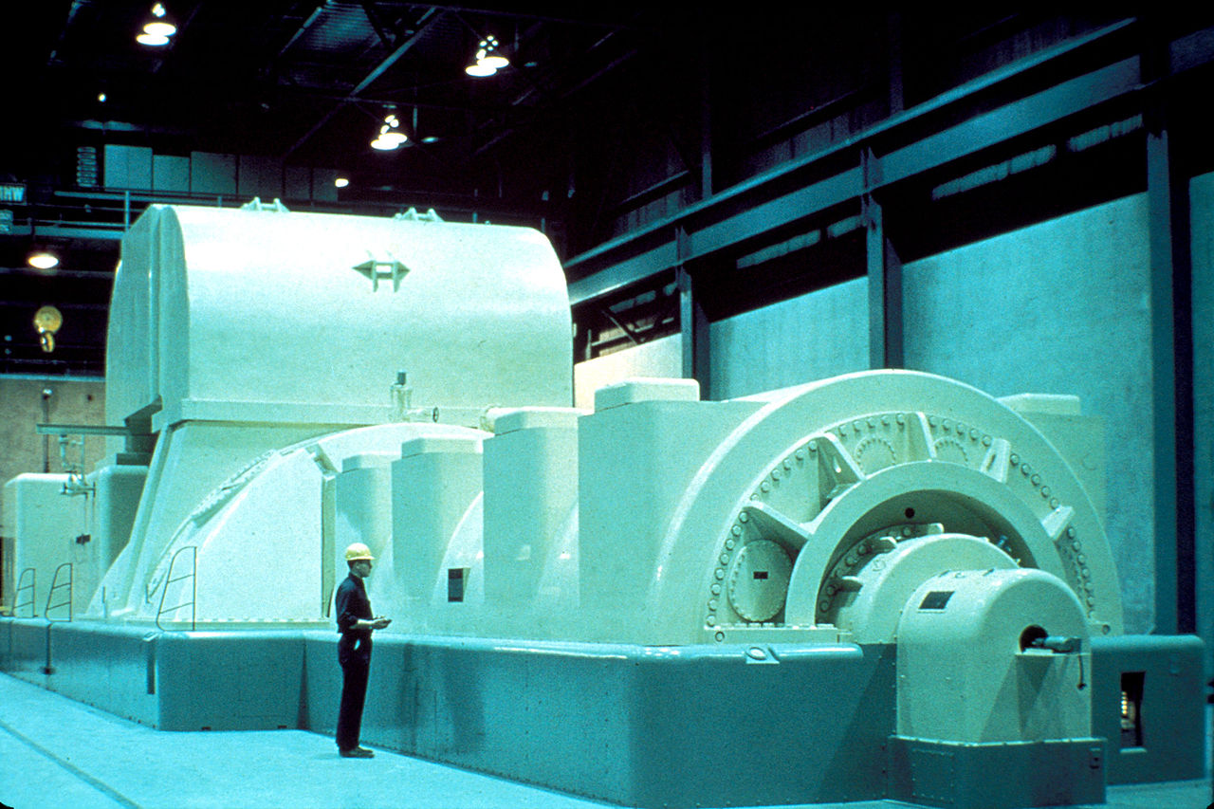
What were they testing?
How long after turbine trip would generator supply rated voltage for essential equipment

Slide 12
Timeline
-12 hours: Reactor powered down to 50 percent, 1 turbine taken offline.
-11 hours: ECCS bypassed C/T test procedure. Load dispatcher asked for continued power operation, power descent halted.
-2 hours: Power descent continued. Setpoint for power descent improperly set, power falls to 30MW. Test required 700-1000MW.
-23 minutes: Power stabilized at 200MW by pulling additional control rods.

Slide 13
Timeline Continues
-20 minutes: Two additional Main Recirculation Pumps were started so that all 8 Main Recirculation Pumps were running. Reactor noted as difficult to control so operators bypassed automatic SCRAM signals for pressure and water level.
-20 to -1 minute: additional control rods were pulled to maintain 200MW. Operators bypassed main turbine trip SCRAM to allow for repeating test if necessary
-1 minute: Operators noted that available reactivity margin had dropped below the level requiring immediate reactor shutdown. Operators continued with test.

Slide 14
Timeline Continues
Test start time 0: Operators trip turbine, four of eight Main recirculation Pumps begin idling. Reactor still at power.
+36 seconds: Automatic rod insertion began but was too slow to prevent power increase, so operator initiated manual reactor SCRAM. Loud noise was heard. Operator noted power was not lowering so they deenergized control rod drives.
+38-39 seconds: Second loud noise

Slide 15
Could something like this happen in US?
Maybe…
Notes:
Nonnuclear experts running tests (numerous examples of safety systems defeated for testing C/T procedures but IAW engineers)
Sophistication in simulation failed soviets

Slide 16
Questions?

